Slide 1
Pressure Mapping
SRGAN Model
BHANU TEJA

Slide 2
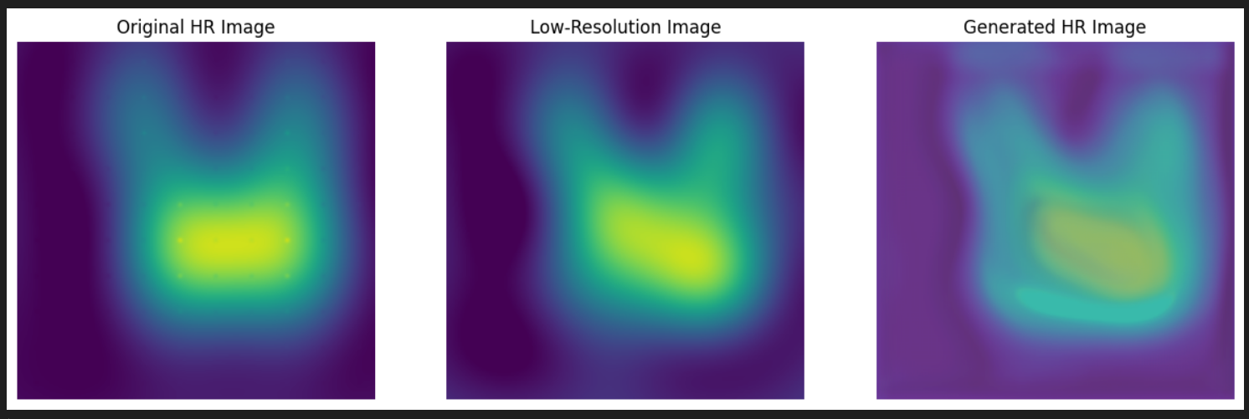
Pervious results

Slide 3
Possible ways to upgrade
Spectral normalization to the discriminator's convolutional layers for more stable training
Different training schedule where generator runs multiple cycles before a discriminator cycle.
Slower learning rate and more epochs.
Implement a gradient penalty for the discriminator.
Training the model with data from new pressure pad.
The generated images came out a bit better after these changes. It’s not a great outcome but some improvement. I have started working with kriging on the new datafrom pressure pad.

Slide 4
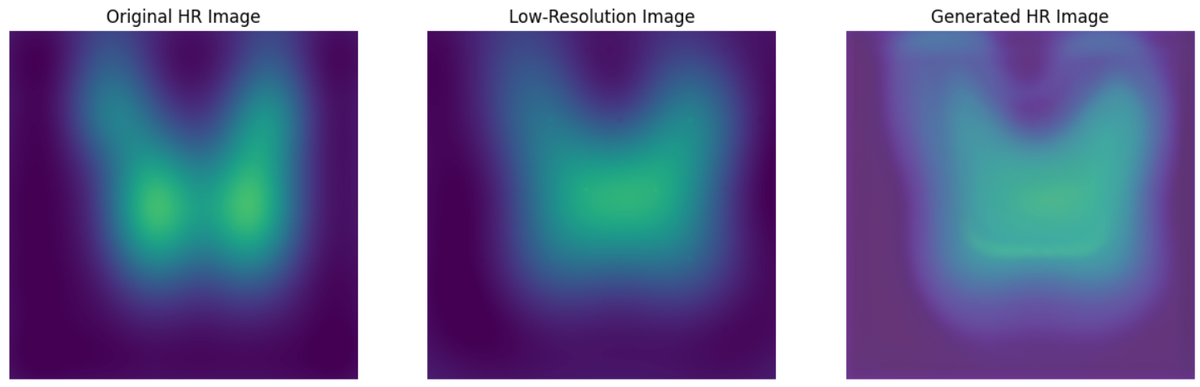
Current Results

Slide 5
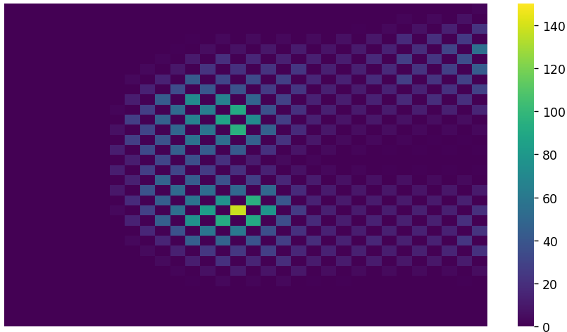
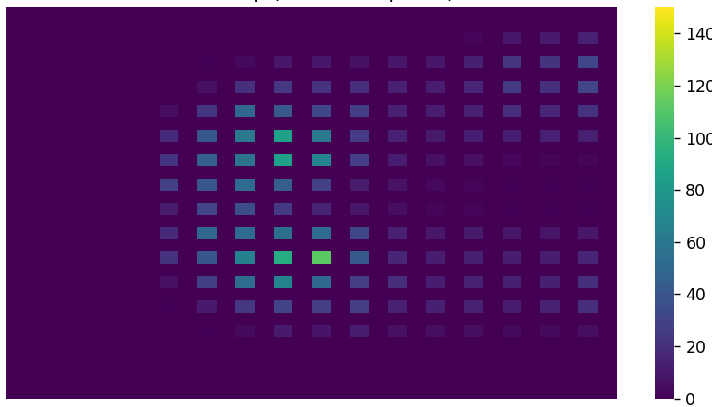
Layout for Kriging
512 data points out of 1024
256 data points out of 1024

Slide 6
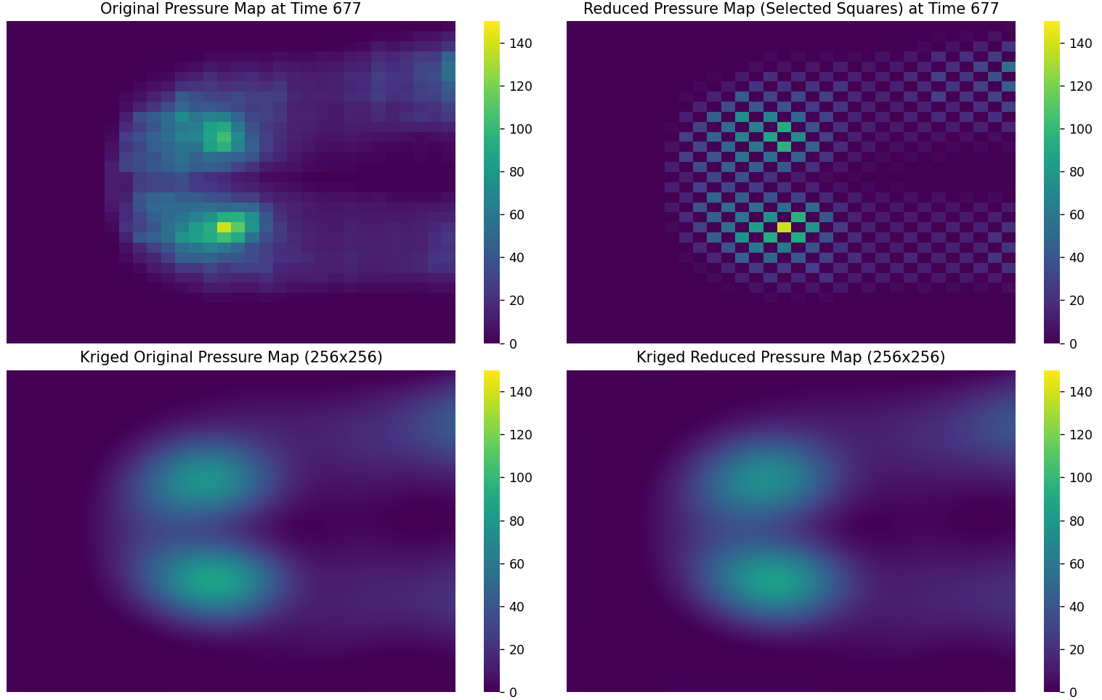

Slide 7
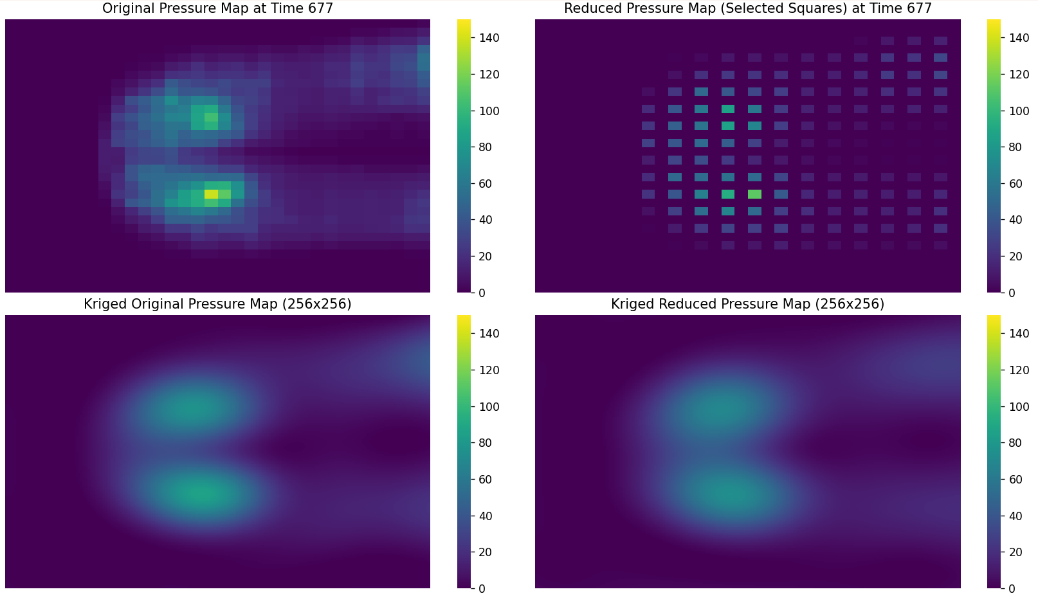

Slide 8
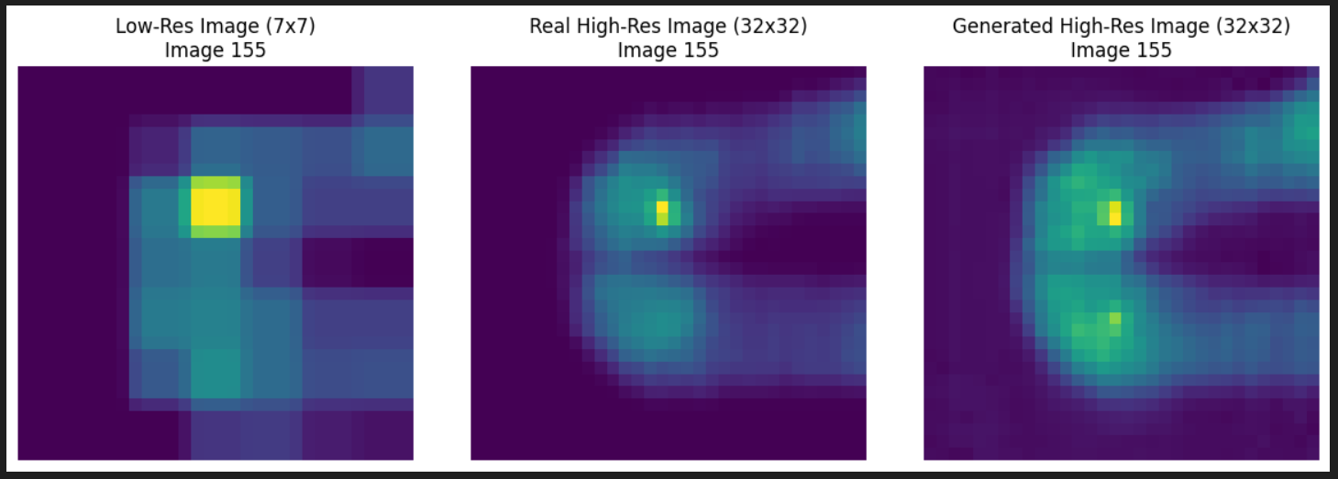

Slide 9
